Slide 1
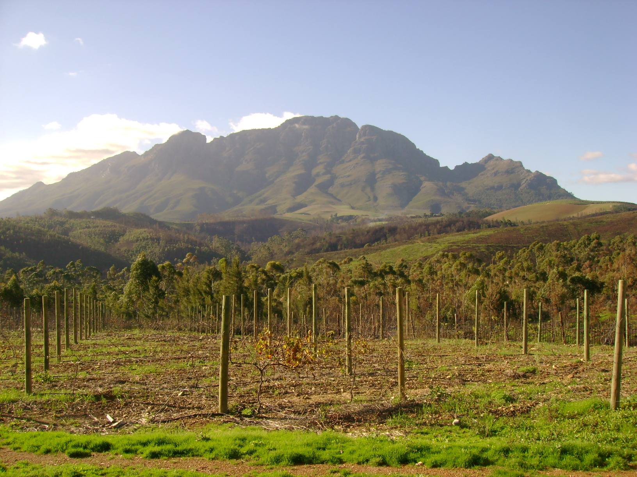
Class 2: More Context & Examples
Larry Swatuk
lswatuk@mta.ca

Slide 2
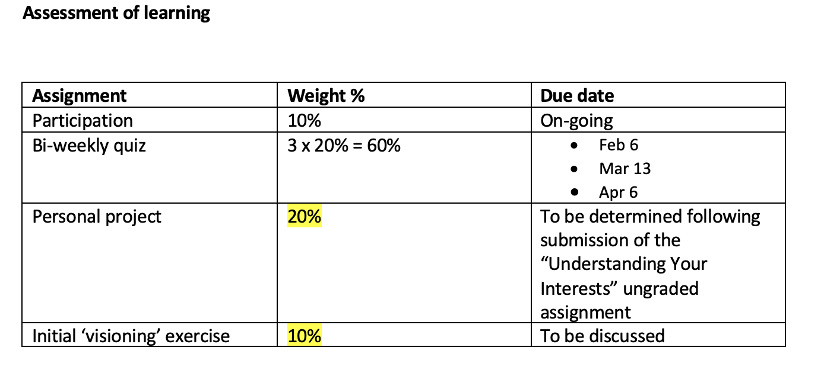

Slide 3



Slide 4


Slide 5



Slide 6



Slide 7
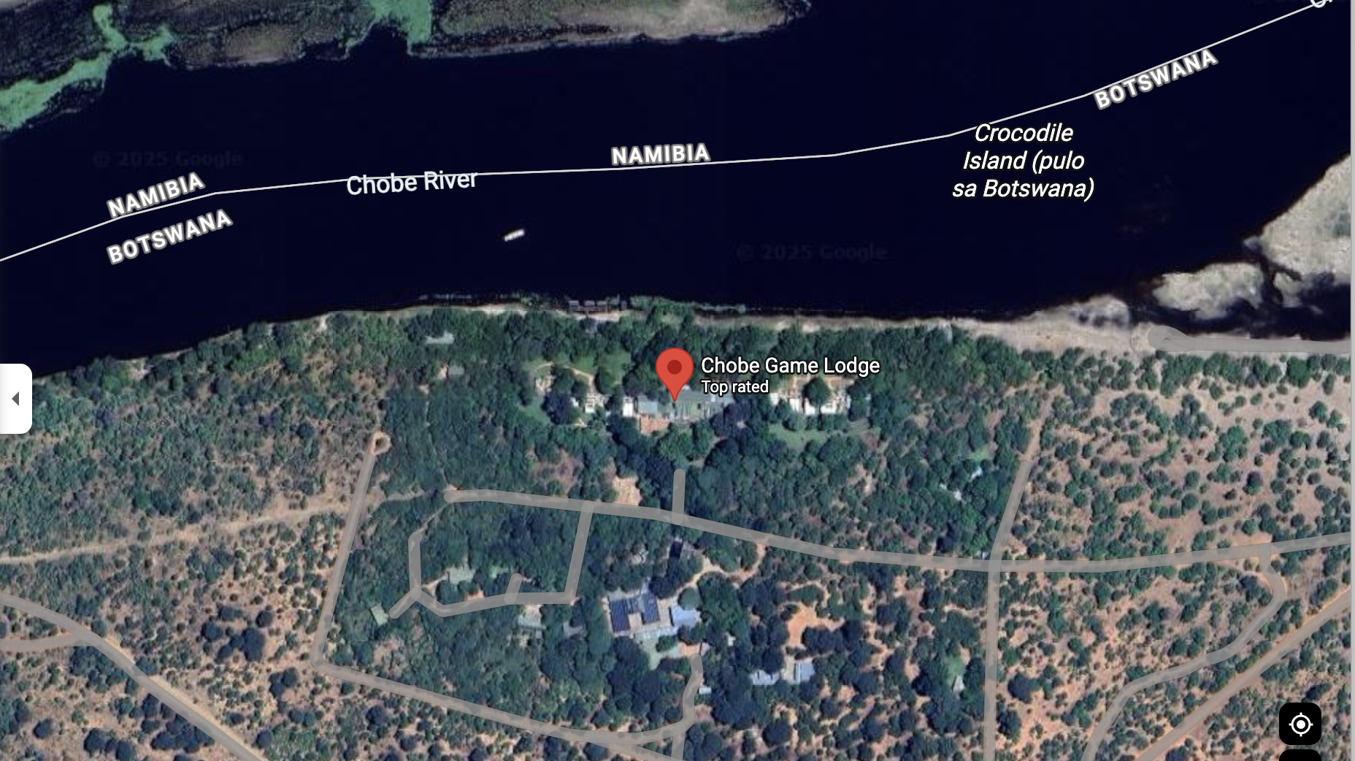

Slide 8
What is an EIA?
‘A process or set of activities designed to contribute pertinent environmental information to project or program decision-making’ (Beanlands & Duinker, 1983: 18).
A process for ‘determining and managing (identifying, describing, measuring, predicting, interpreting, integrating, communicating, involving, controlling) the potential (and real) impacts (direct and indirect, individual and cumulative, likelihood of occurrence) of proposed (or existing) human actions (projects, plans, legislation, activities) and their alternatives on the environment (physical, chemical, biological, ecological, human health, cultural, social, economic, built and their interrelations. (Lawrence, 2003: 7).

Slide 9
What are necessary steps?
What are the Government/Private Sector stated goals?
Profit
Sustainability
Community engagement & betterment
Establish a baseline (pre-process process: what is known)
Literature review
Scoping exercise
Stakeholder mapping
Risk analysis
Gap analysis
Develop a process

Slide 10
8 Criteria for Determining Best Practices for EIA (from Sinclair & Doelle, 2010: 64)
A strong legal foundation establishes EIA as a mandatory and enforceable process, and one that provides clarity, certainty, fairness, and consistency
A broad definition of the environment and related processes stipulates requirements to ensure EIA is applied to all environmentally significant undertakings.
The EIA process identifies the best options rather than merely acceprable proposals and requires critical examination of purposes and comparative evaluation of alternatives to the initiative as well as of alternative means to undertake the proposal.

Slide 11
EIA best practice continued
The EIA process limits ministerial discretion
The EIA process is open and fair, provides a significant role for the public, and contains provisions for public notice, comment, access to information, and participant funding
The EIA process has enforceable terms and conditions for approval of an initiative
The EIA process explicitly addresses monitoring and other post-approval follow-up to ensure terms and conditions are met.
The EIA process ensures assessment work is connected to a larger context, including establishment of overall biophysical and socio-economic impacts.

Slide 12
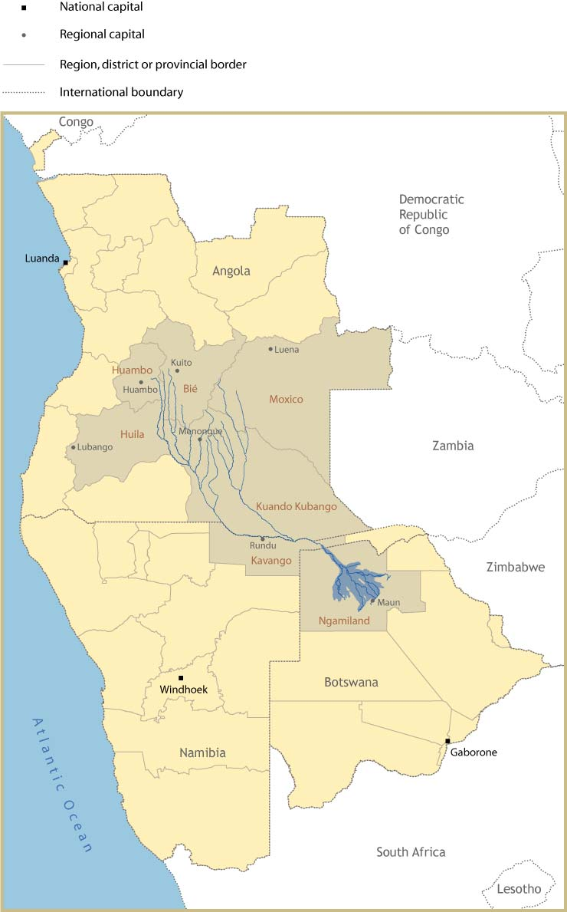
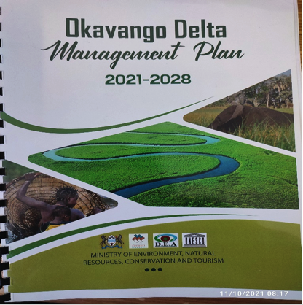
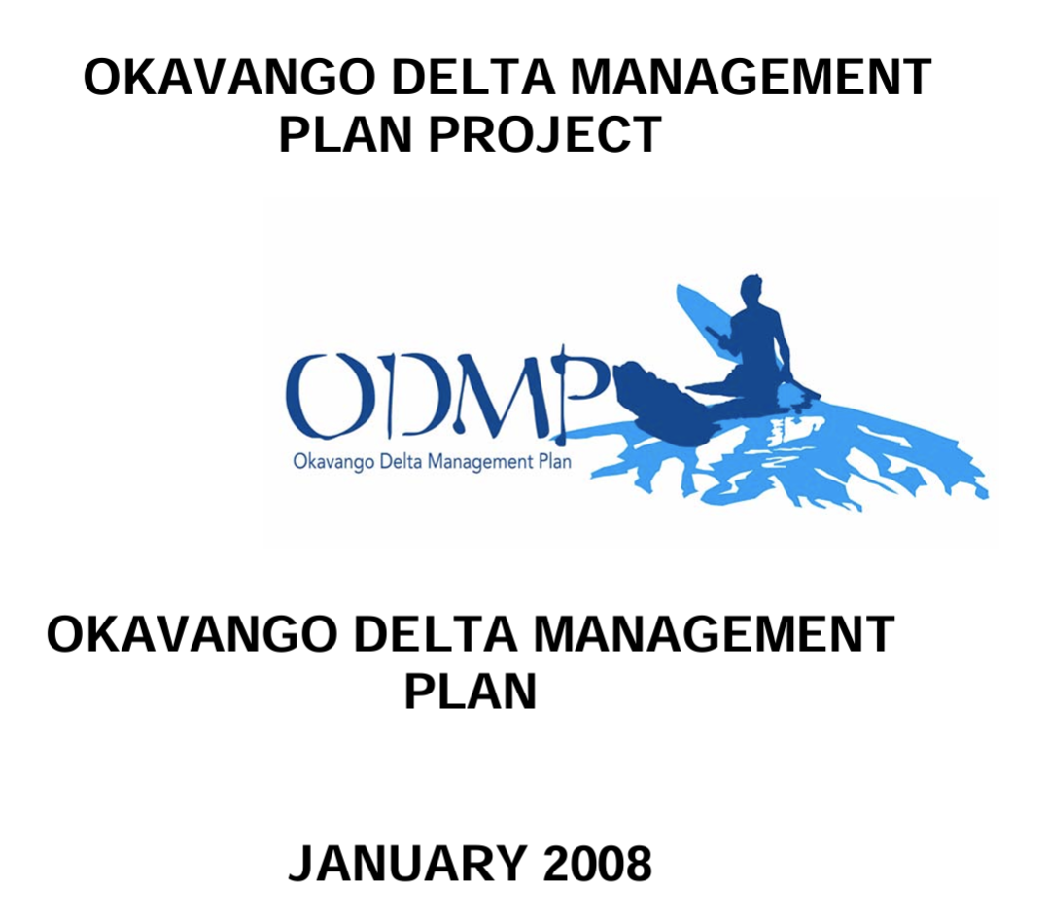
Flood Pulse Environment

Slide 13
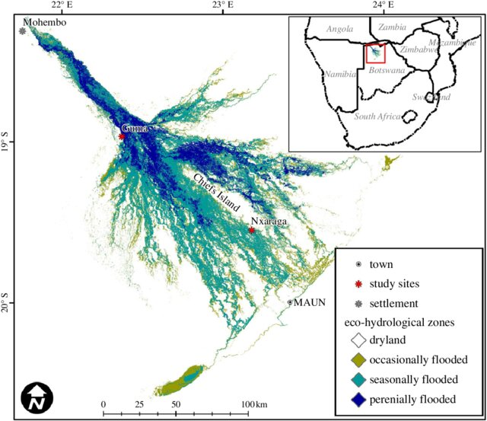

Slide 14
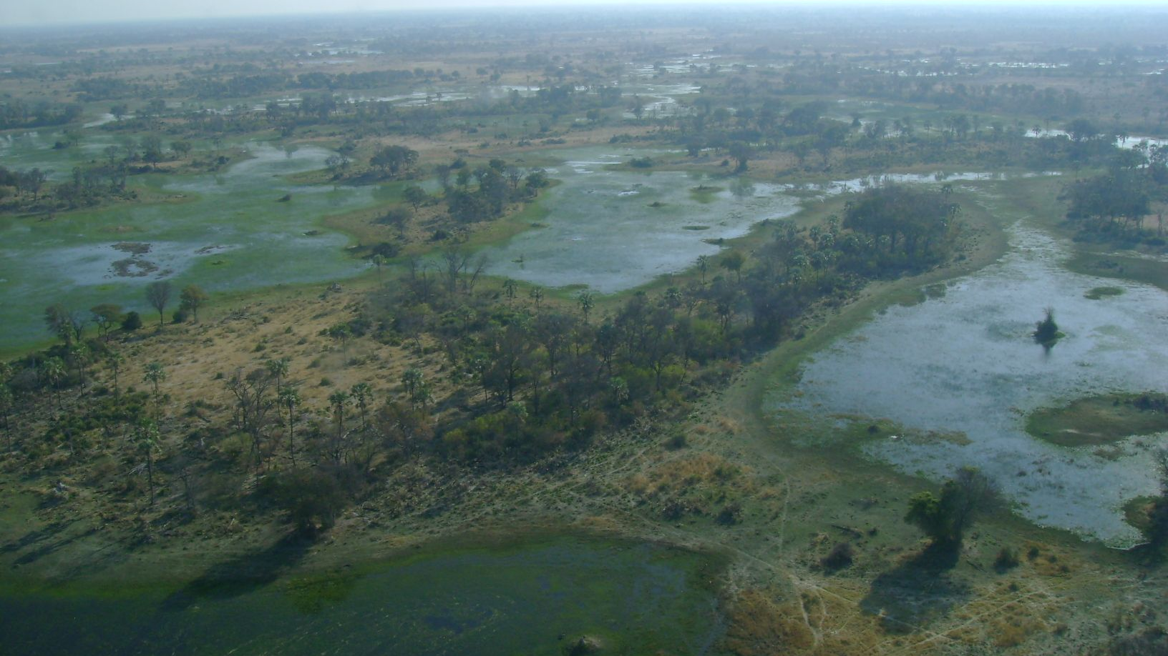

Slide 15

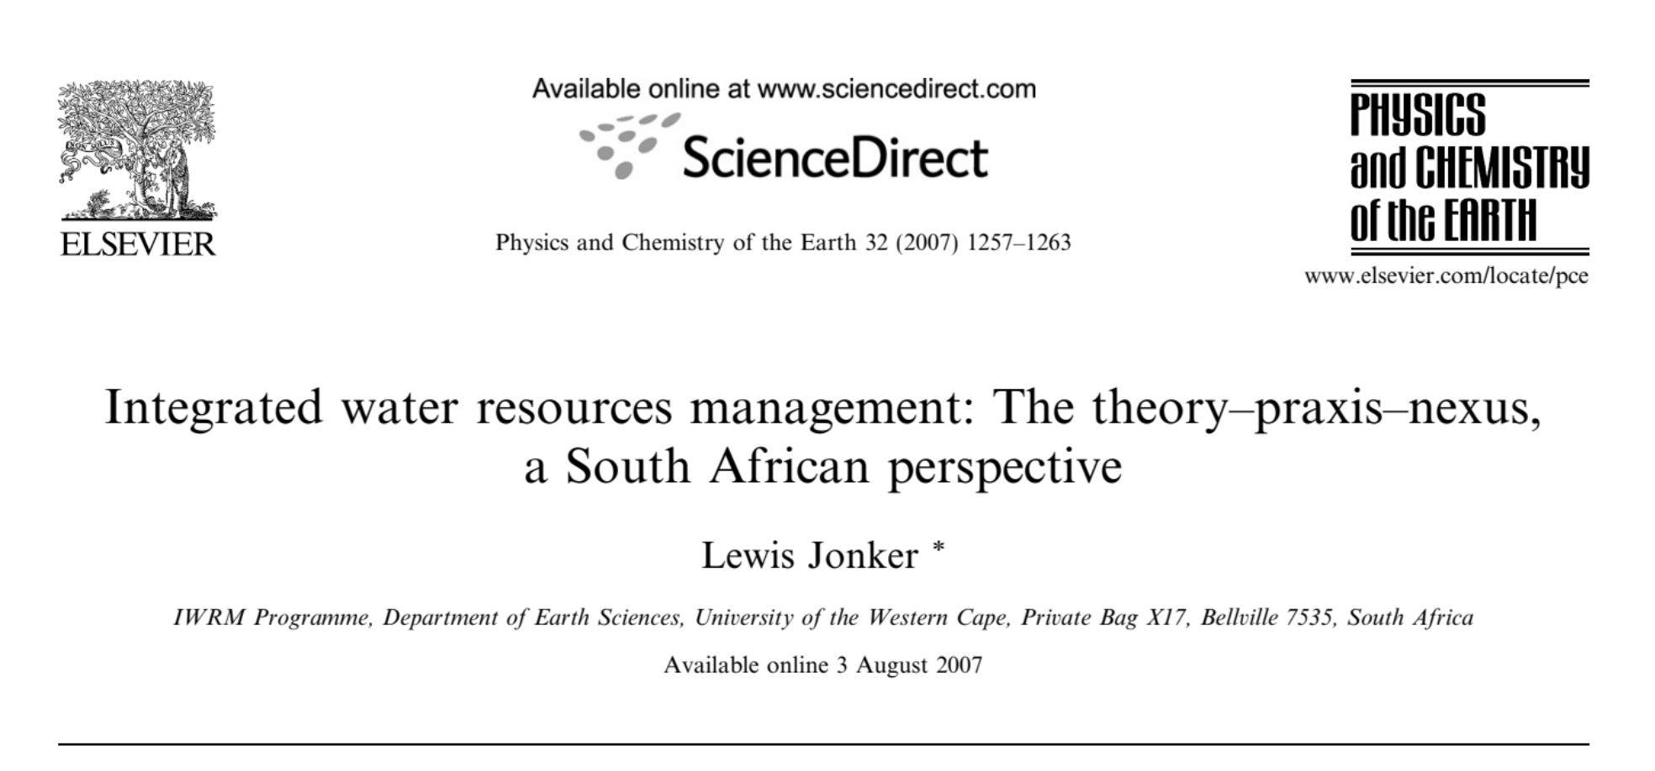
‘If you are always planning, you are never failing’
Lewis Jonker

Slide 16
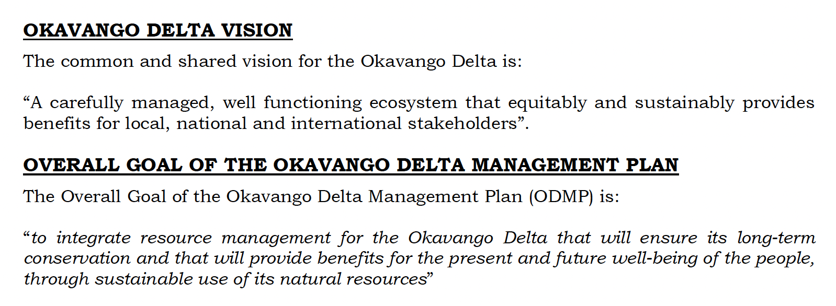

Slide 17
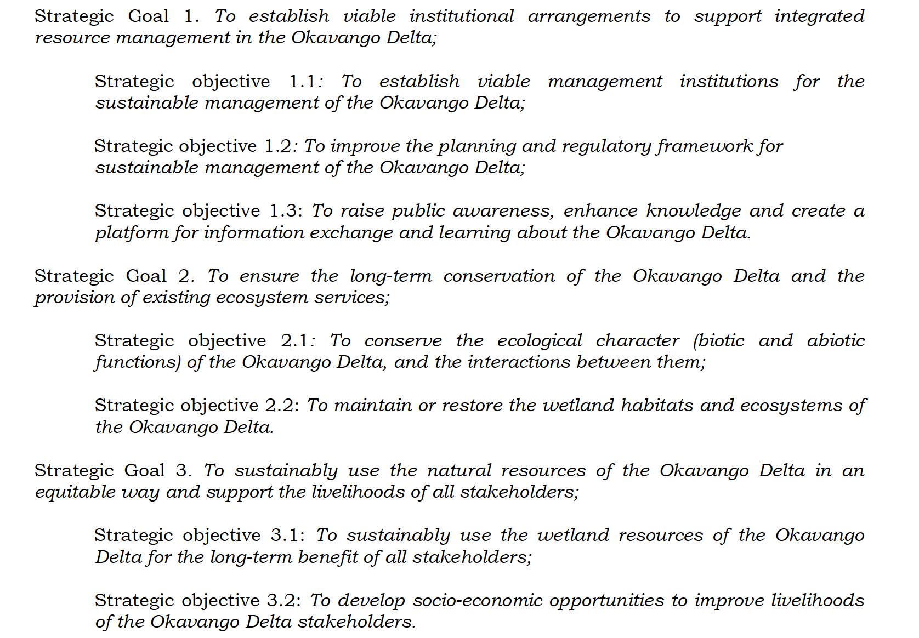

Slide 18

Stakeholders
“Persons or groups with a legal responsibility relative to a problem or issue, or likely to be affected by decisions or actions regarding the problem or issue, or able to pose an obstacle to a solution of the problem or issue.

Slide 19
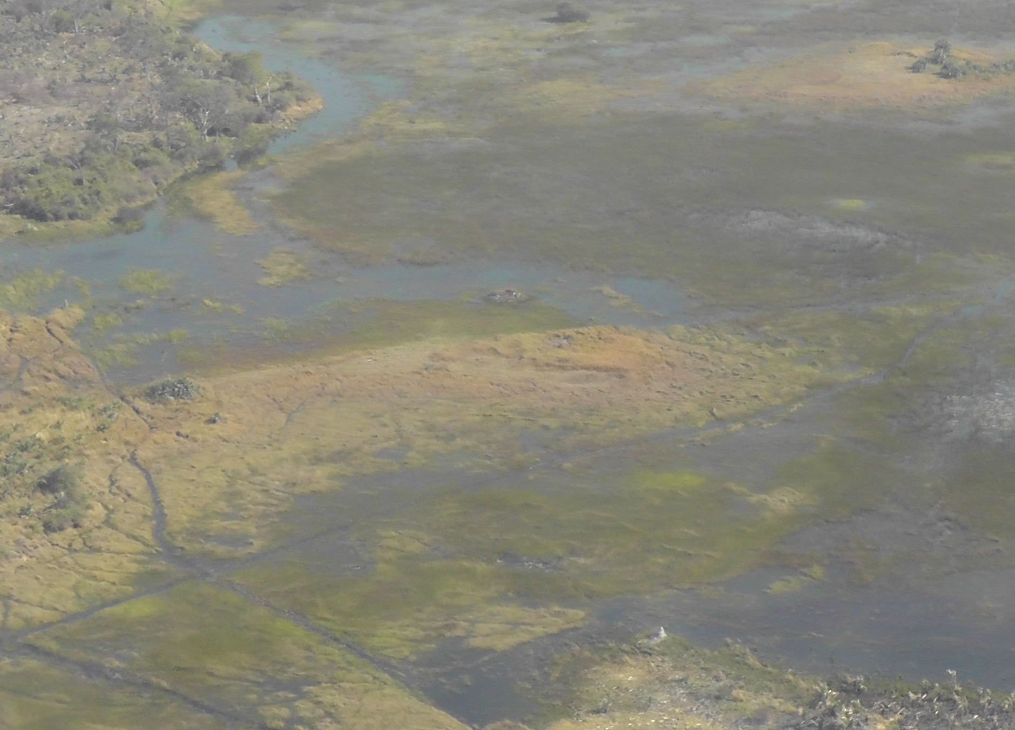
Okavango Delta Stakeholders
Within the Delta:
Physically outside of the Delta but affected by actions in the
Delta:
Within the country
Within the basin
Within the region
Wtihin the world

